Slide 1
Week 4(10.23-10.30) Progress Report
Siyu Zhang
10.30
https://github.com/CU2018/C_U-Fish-Blender-Ray-Tracing

Slide 2
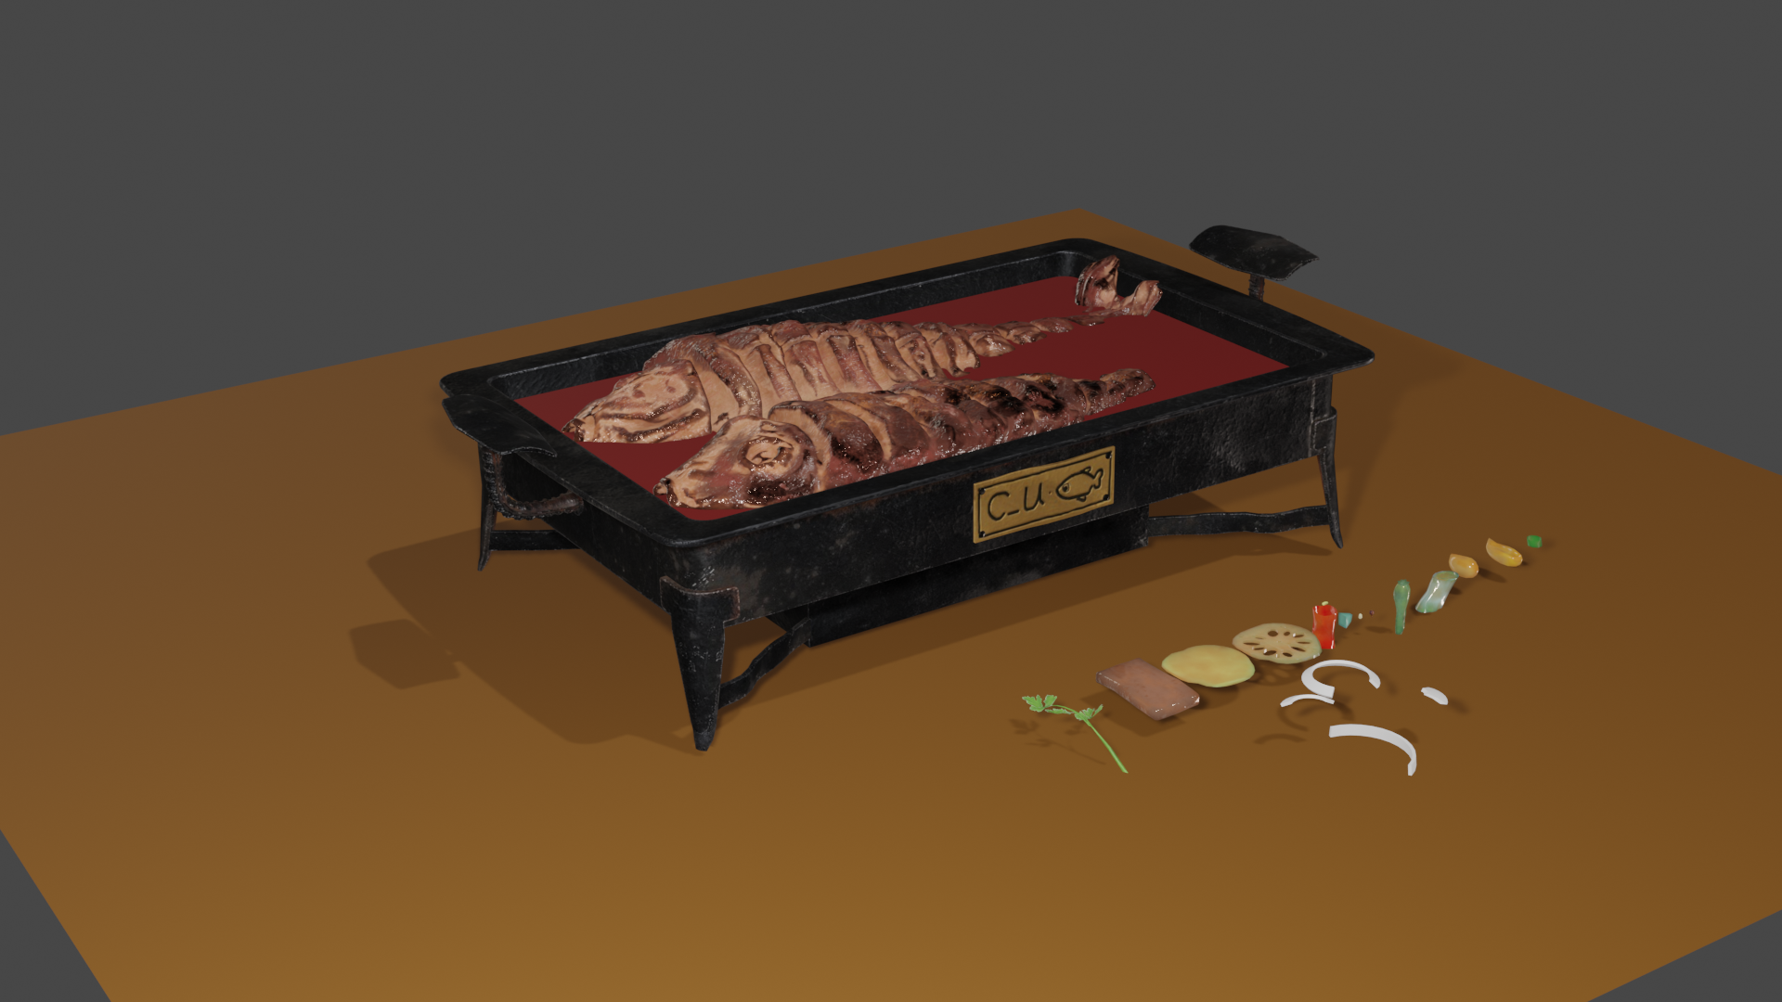
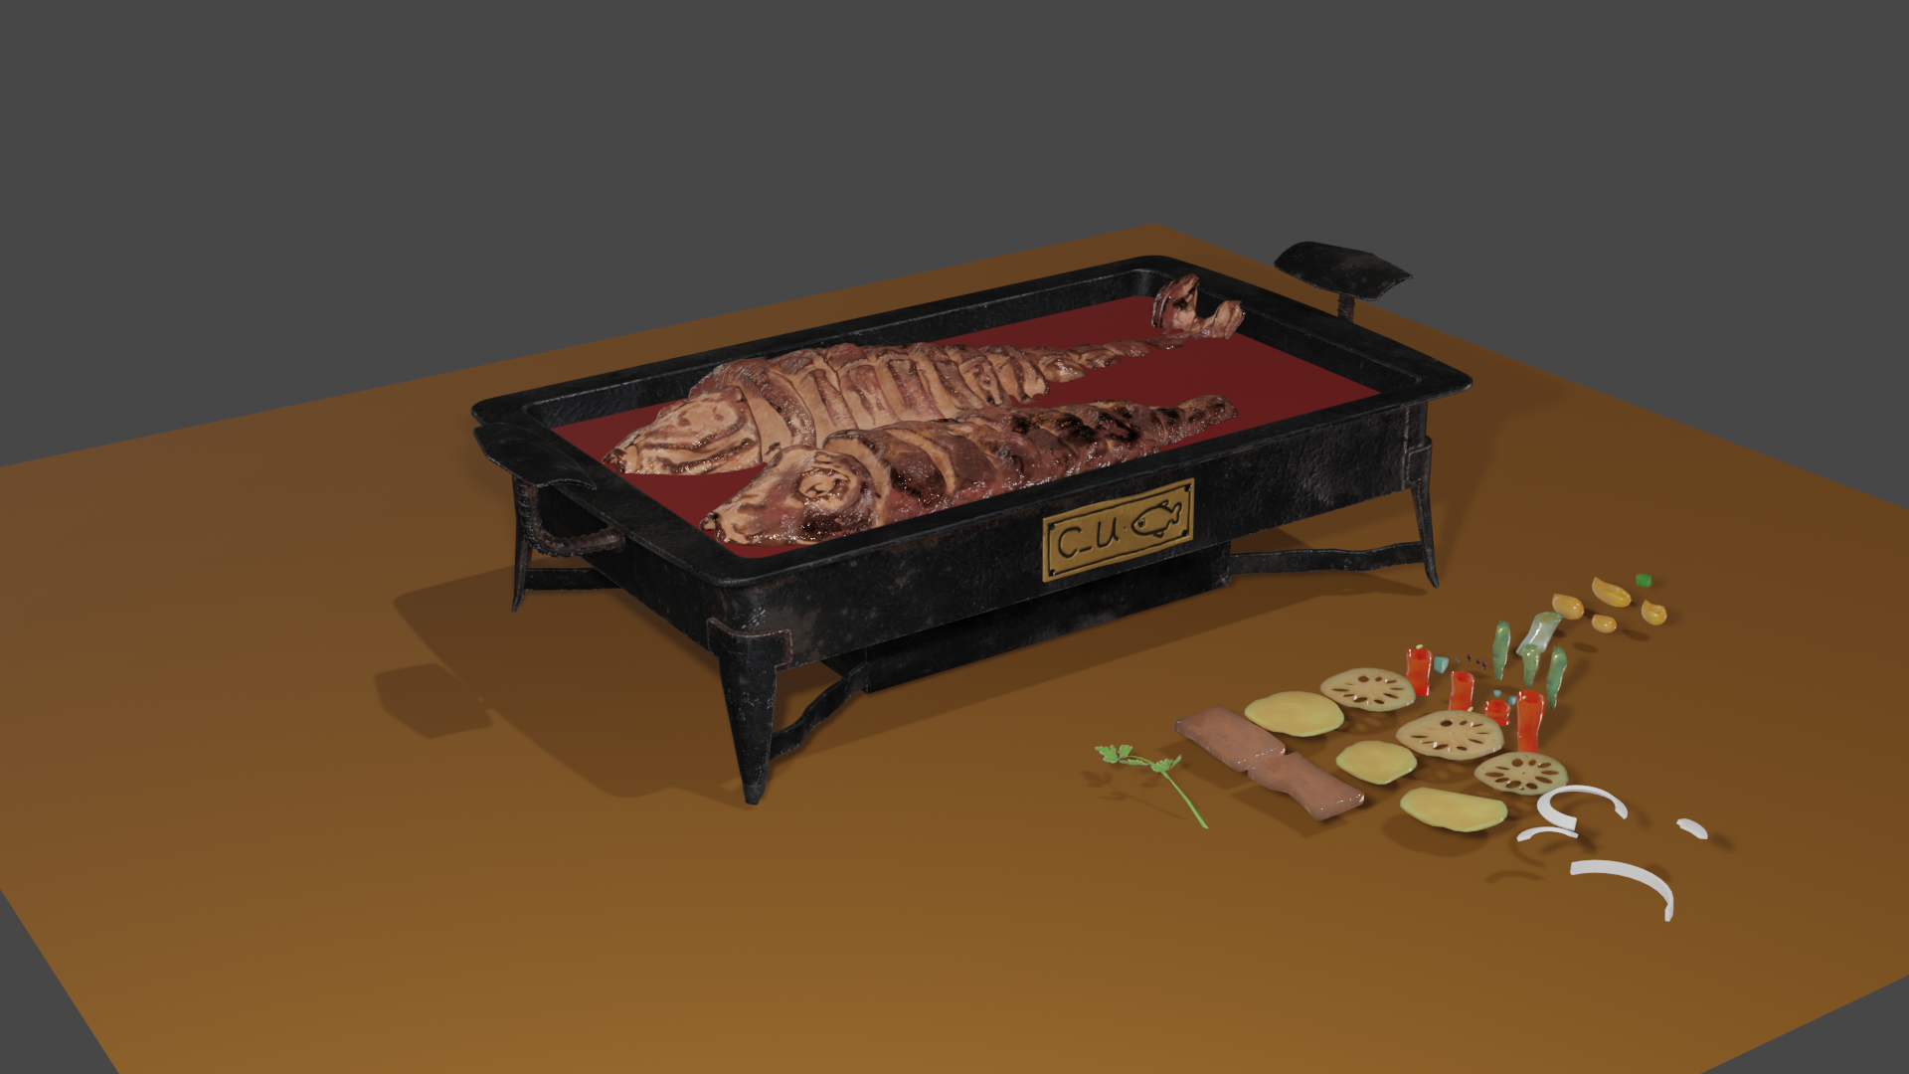
Update: UV and Texture
Finished textures for vegetables
Added more variations of side vegetables

Slide 3
Update: Rigid Body & Particle System
Added the vegetables to the plate
First Layer Second Layer

Slide 4
Update: Special Effects -- Fluid Effect (Smoke & Fire)
Created and manipulated the parameters for making better visual effects
still need to be improved

Slide 5
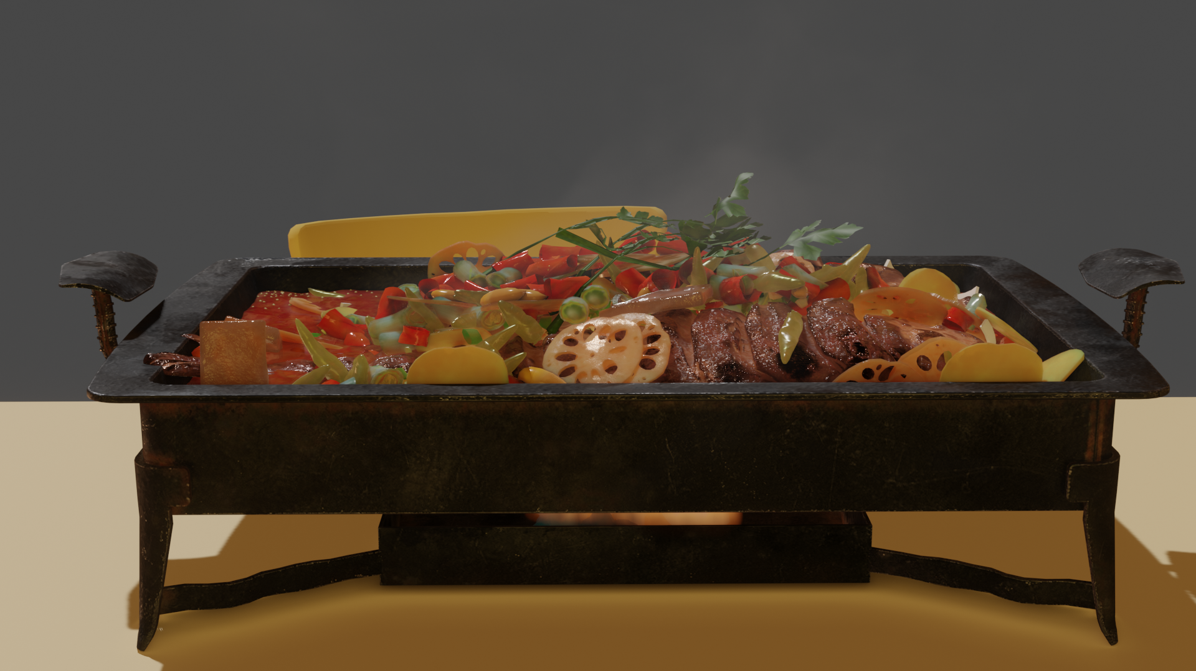
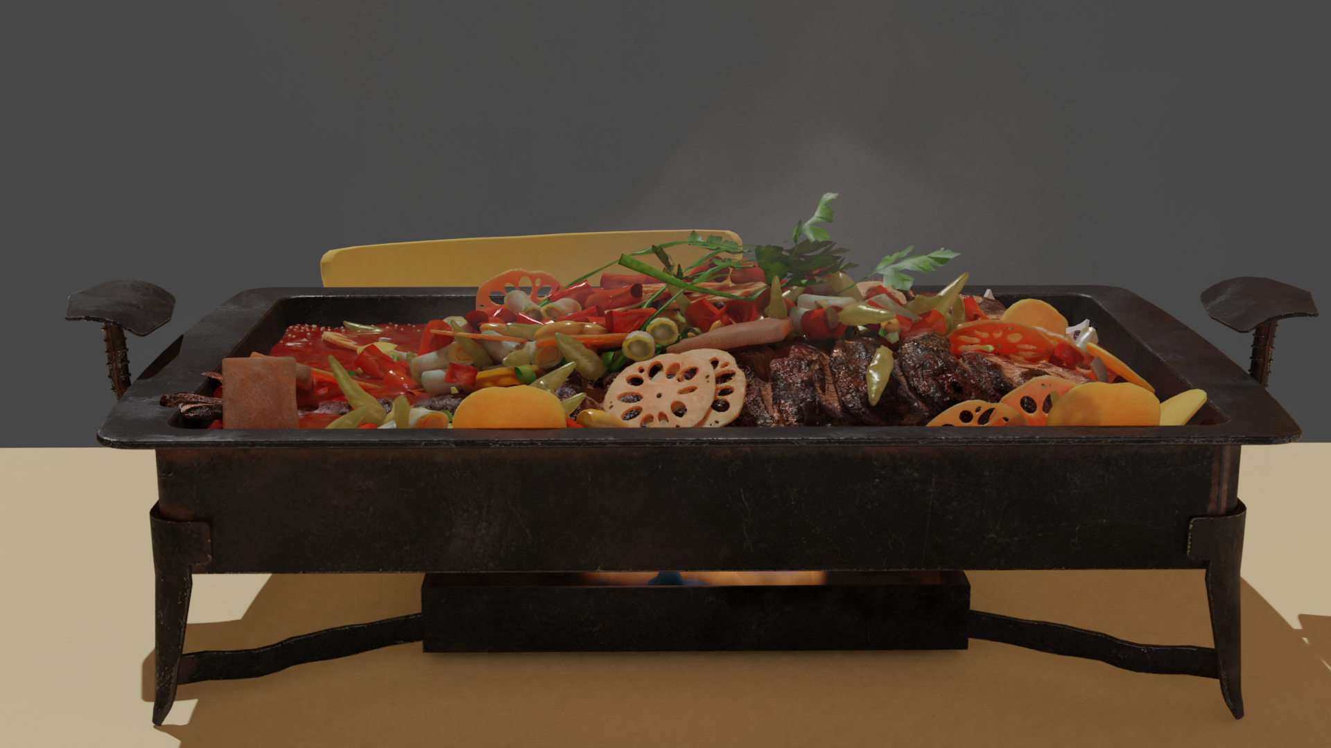
Update: Eevee lighting settings vs. Cycles
Frame 140 Eevee
Frame 140 Cycles

Slide 6
Takeaways for this week
Blender shading nodes: Principle PBR node
Blender Rigid Body for simulation
Blender Particle System
Quick Smoke (Smoke and Fire)
Eevee lighting settings vs. Cycles
Somehow Eevee has a better rendering result than Cycles

Slide 7
Plan for the next week
Cycles lighting
Learn and list the necessary parameters for making good lighting
probably could integrate them into an Add-on

